Slide 1
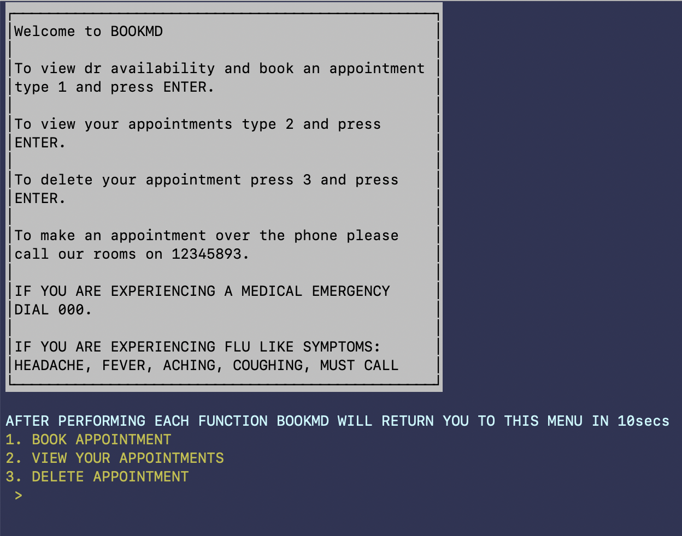
BookMD
A mock online appointment booker

Slide 2
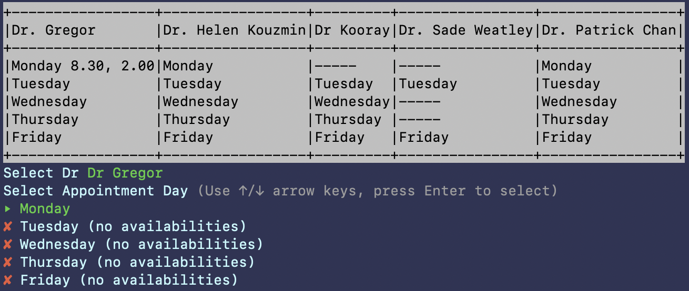
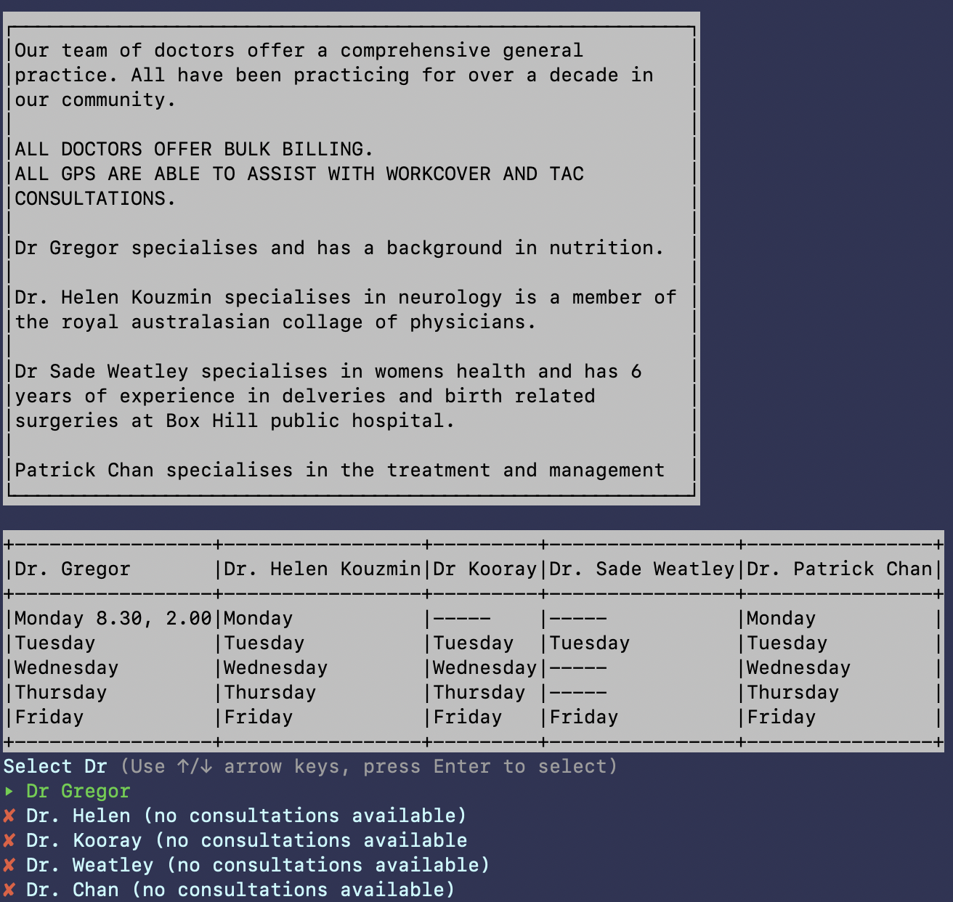
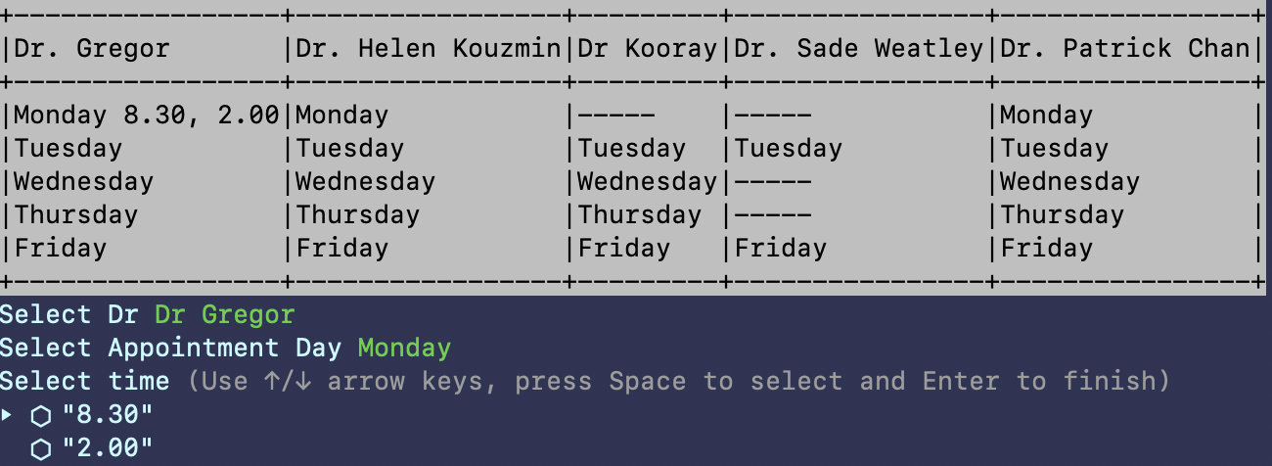
APPOINTMENT SELECTION

Slide 3
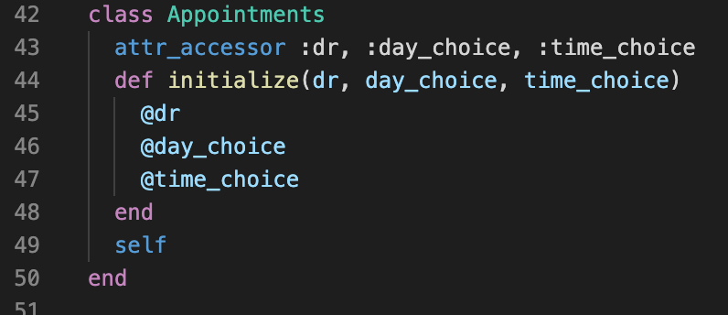
Appointments
All have instance variables dr, day_choice and time_choice

Slide 4
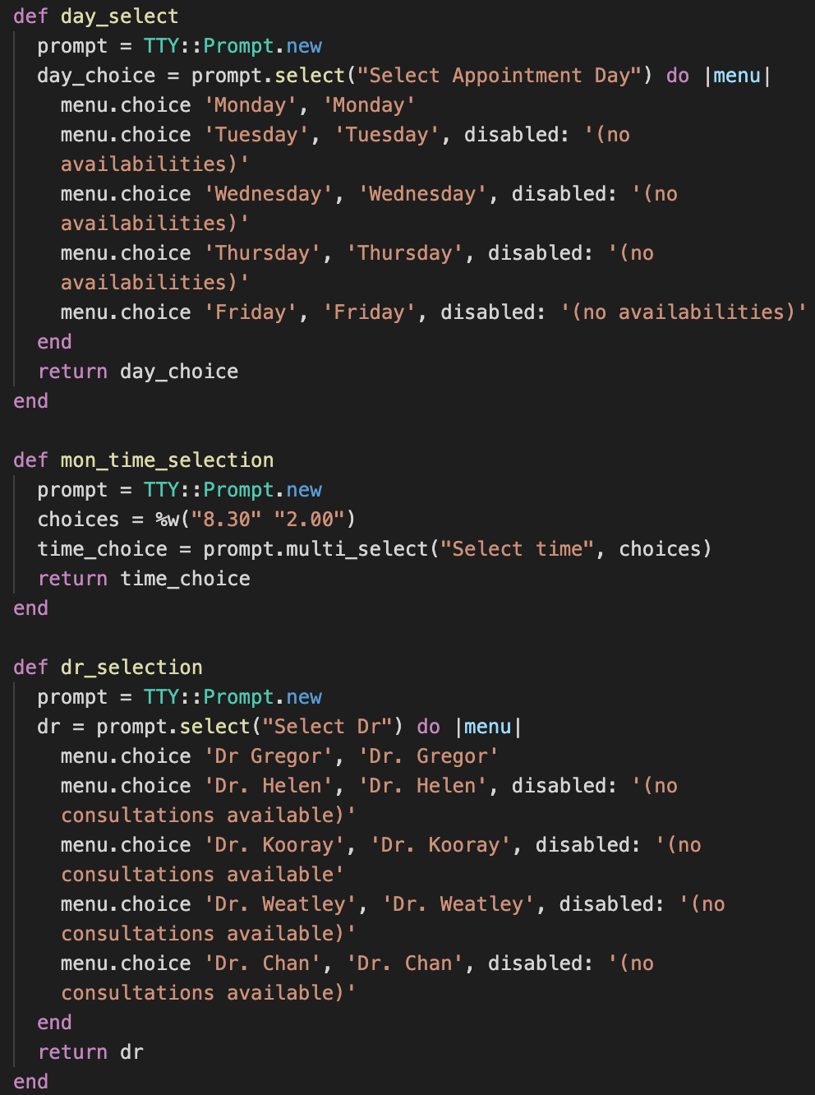
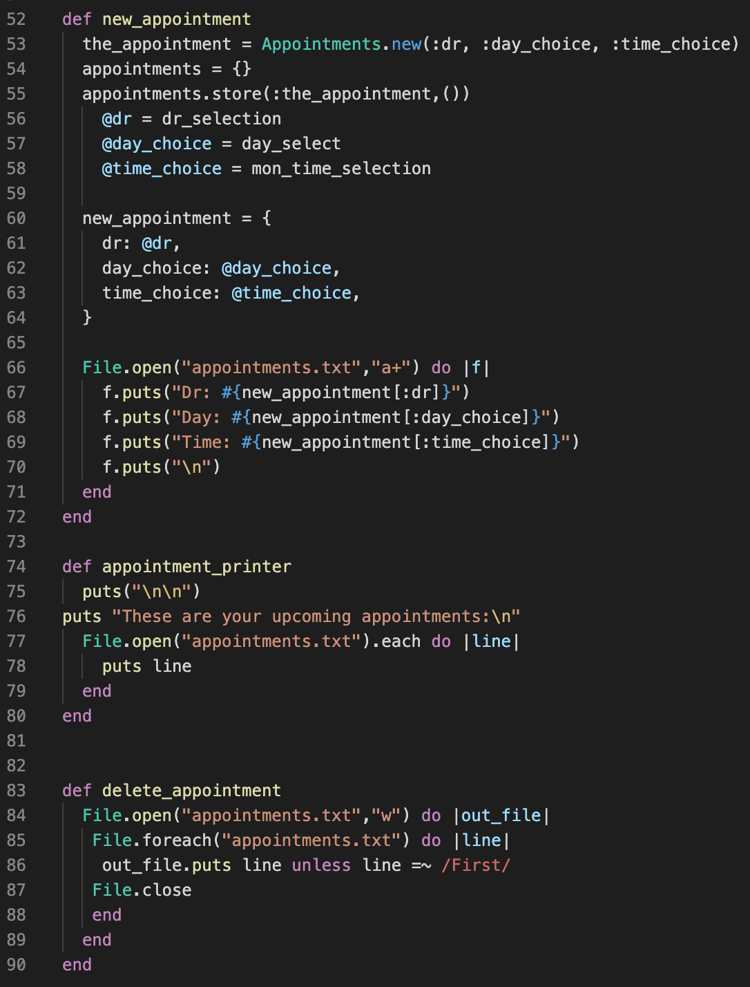
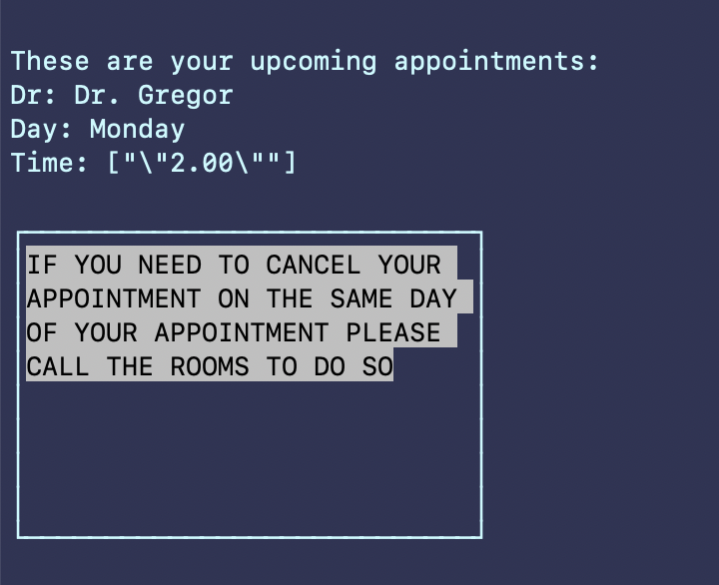
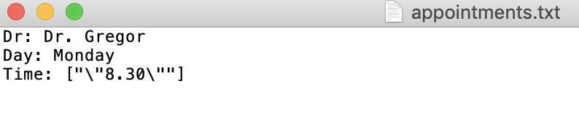
Appointment_printer method reads and displays the appointment.txt file to the user
TTY prompt : my way of avoiding invalid selection by providing a menu + more interactive and intuitive

Slide 5
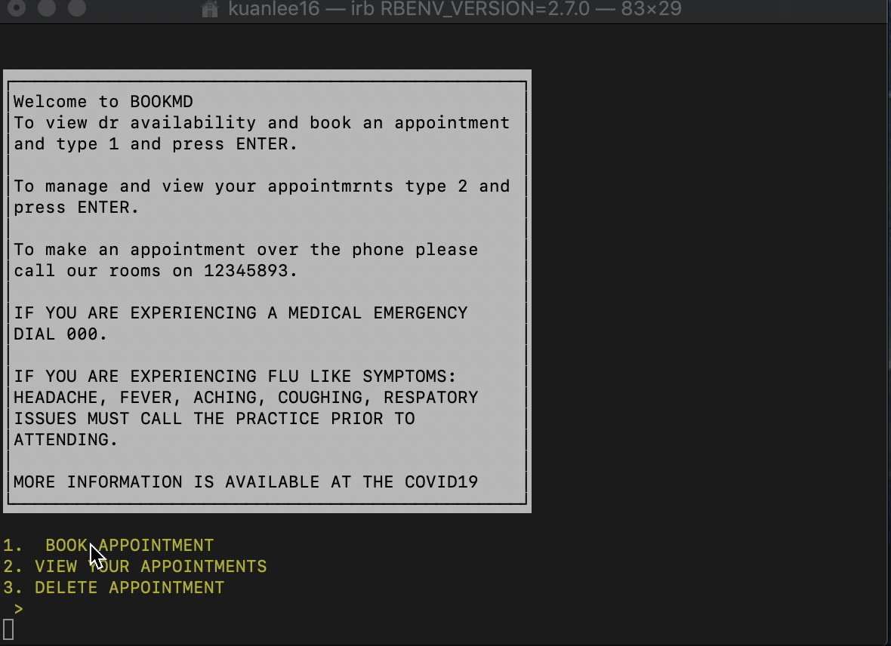
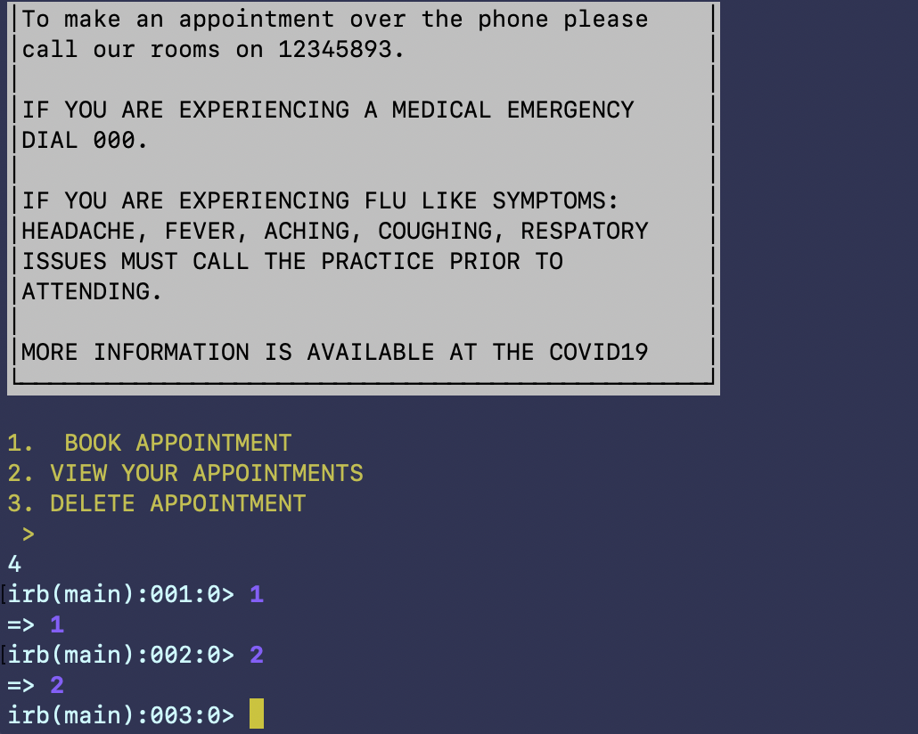
MANUAL TESTING
I had trouble writing rspec tests for my code due to time constraints.
One way for me to do some tests was get my housemates and classmates to have a play with the app.

Slide 6
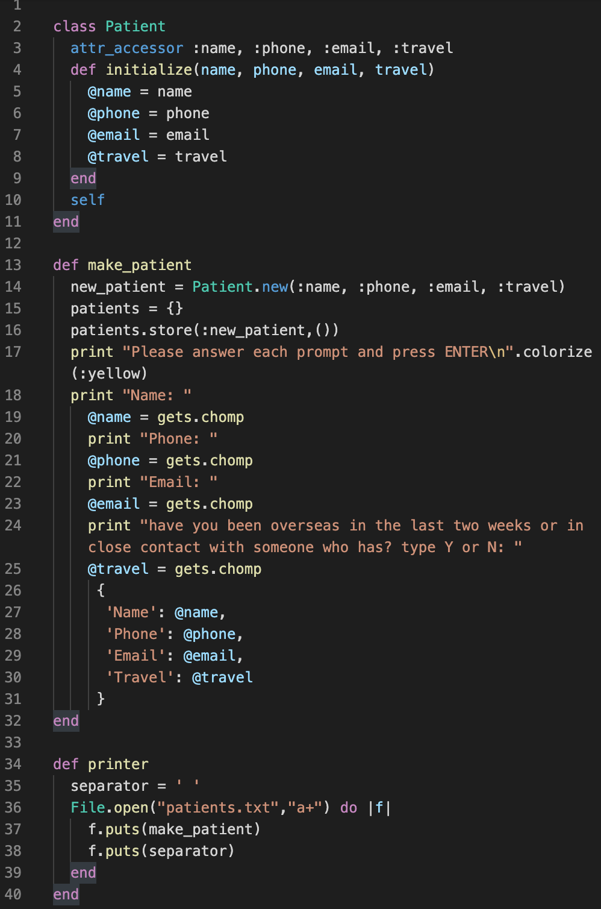
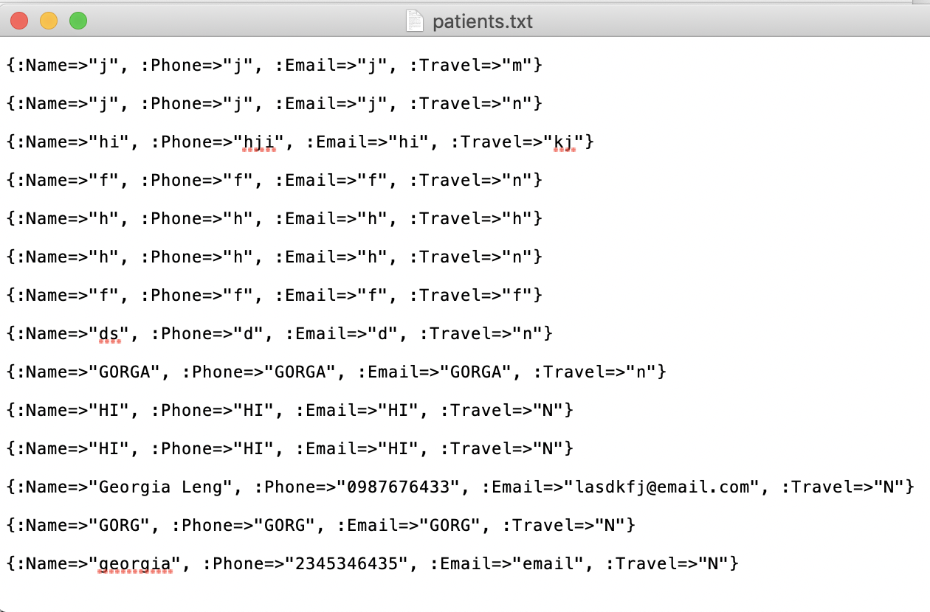
WRITING AND READING FILES IN RUBY
Append flag
Gives us this hash in patients.txt

Slide 7
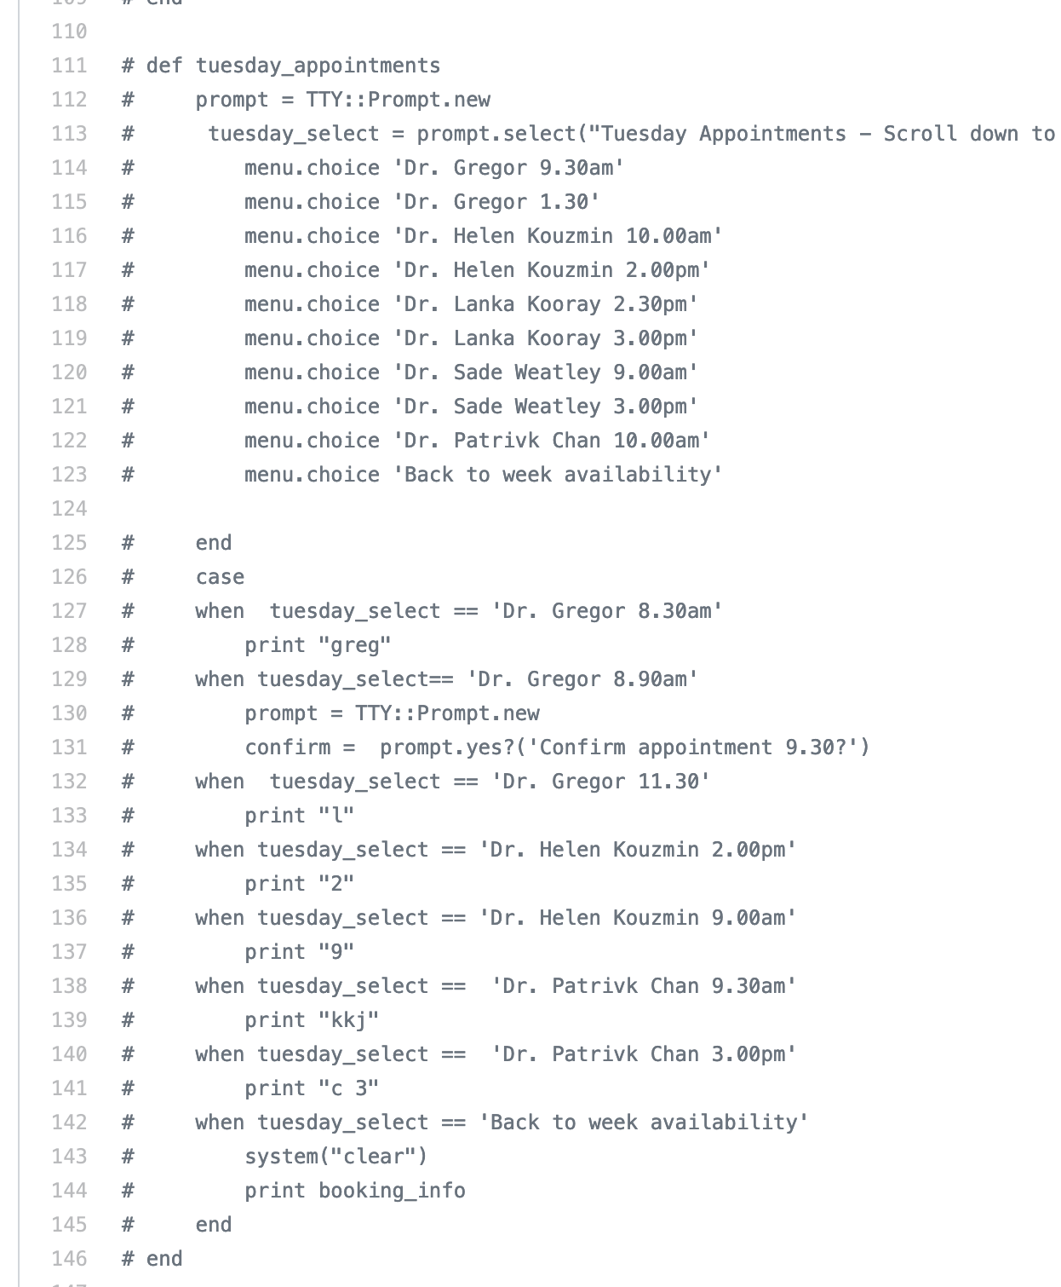
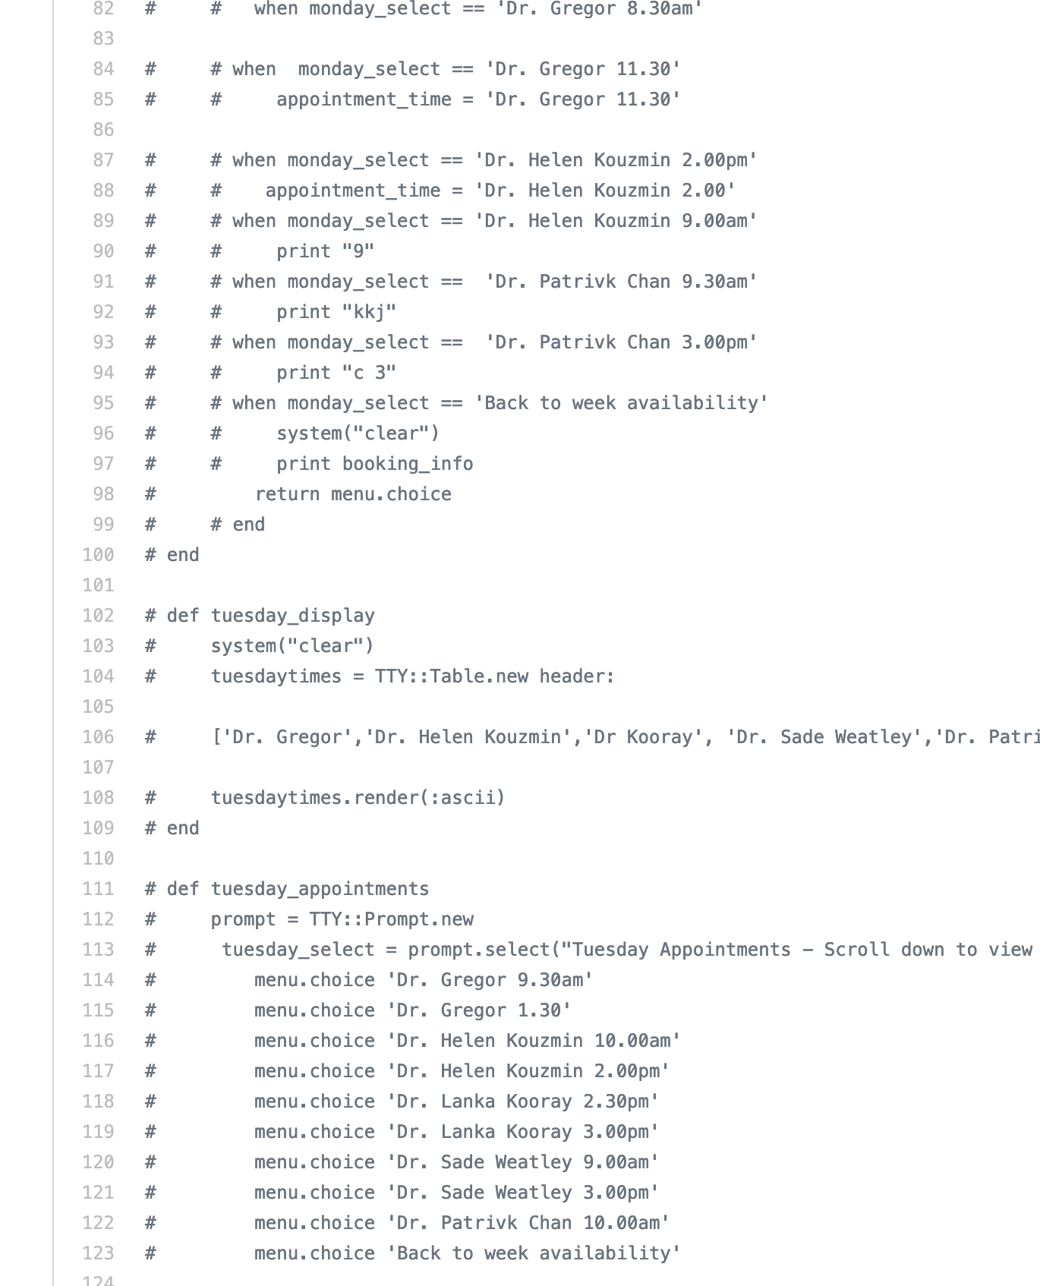
Challenges and scope
It would function as a pizza booker.
In a time-line appropriate for this project I wasn’t able to create an app with the dynamism of a two way system. But I did create the elements I wanted to. 1- book appointments
2 –view appointments
3- delete appointments
4 – have appointments and patient info written to text files

